Slide 1

Project Vlog #5
By The 4 Codesmen - Abraham, Dhruv, Dinesh, Favor
ENSE 400/477(2022-2023): SSE Capstone

Slide 2
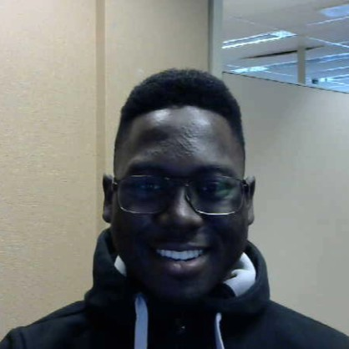
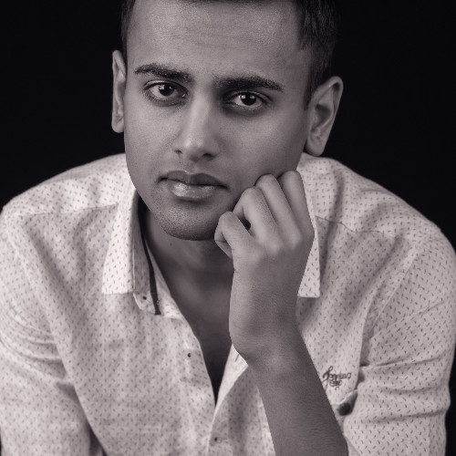

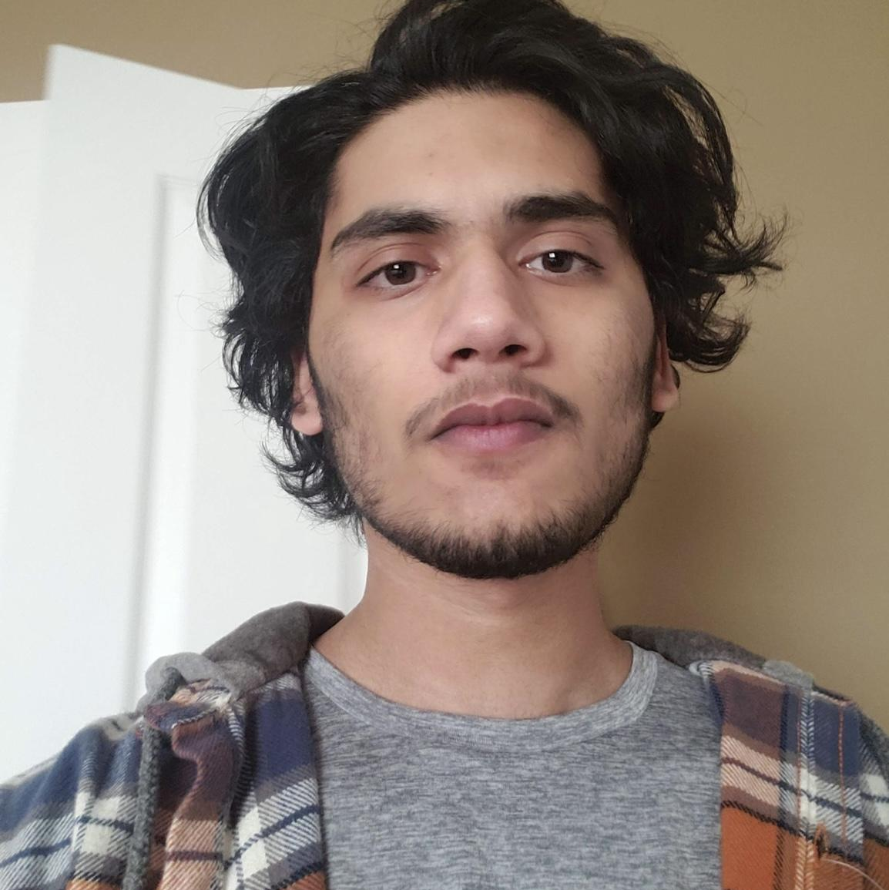
Team Members
Favor Fasunwon Full Stack Developer and UI/UX Designer
Dhruv Modi Team Lead and Full Stack Developer
Abraham Mugerwa Full Stack Developer and Documentation Manager
Dinesh Dalip Software Architect and Full Stack Developer

Slide 3
Project background & business need/opportunity
For our capstone project we are building a web application for UR residence that allows its tenants to:
Build a community (decrease social gap)
Take charge with the ability to report incidents
Stay up to date with events on residence
Live in an atmosphere that resembles home
Current Situation?
Only made for U of R at the moment
Opportunity?
Introduce this concept to other universities in Canada
Notes:
Current Situation
Currently U of R Residence does not have a dynamic application that brings U of R Students together. There is an application for U of R Residence however it is outdated and requires a major upgrade.
Opportunity
Build an application for U of R residence that
Replaces the old application
Enhances the experience of living on campus
Go beyond U of R and share this digital ecosystem with other University Residences as well.

Slide 4
Project/Work Activities
Feb.3, 2023 - Feb.10, 2023
Team: Updated the frontend (improving the aesthetics), Merge all optimized, upgraded and new features, began first phase of deploying the app.
Dhruv: Conducted interviews for user feedback with Dinesh, worked with Abraham to document priorities of features based on interview conducted, completed Dashboard feature.
Abraham: Worked with Dhruv to document priorities of features based on interview conducted. Completed recipe page with its newest functionality (allowing users to input whatever ingredient they have and the app produces a list of recipes according to that query)
Dinesh: Conducted interviews for user feedback with Dhruv. Completed Chat feature with add/delete group functionality with Favor. Completed feedback feature (new feature - complaint box) with Favor.
Favor: Updated Kanban, completed Chat feature with add/delete group functionality with Dinesh, Implemented feedback feature functionality with additional CSS customization from Dinesh.

Slide 5
Addressing Scrum Comments
Scrum comments:
Have you tested with users?
Not presently, we decided to get the app deployed before acceptance testing, which should happen this coming week
Have you mapped out your stakeholders?
Yes, Since this app is made for UR residence our stakeholders include UR residence and U of R
Who is your target customer? The students in residence with an added experience for RAs (Residence Assistants are students as well with an added responsibility of maintaining Residence)
Are you focusing on the right things?
After the interviews it was clear we were not focusing on all needed features, thus we made changes to our business case adding a new feature (digital complaint box) to complete the overall end-to-end experience.
Are you (on track to) fulfilling their needs?
After conducting the interviews its was concluded that their needs were being fulfilled
Have you documented the end-to-end experiences and their priority?
As of now the end-to-end experiences and their priorities have been documented. They can be found on our Github

Slide 6
PROJECT DEMO

Slide 7
Next Up
Kanban (https://github.com/orgs/The-4-Codesmen/projects/1/views/1)

Slide 8
Team Reflection
Does the team feel "on track"? (reiterate the above colour status)
Green Status. All features on the app is completed.
What progress does the team particularly feel good (great) about?
Receiving more feedback from students in residence and knowing we fulfilled most of their needs.
What barriers (if any) does the team feel are a current impediment to success?
Future cost for APIs and Web hosting, and some potential issues with deployment.
What help (if any) does the team require to move positively forward?
None at this current time, but we will reach out if issues arise.
What questions or concerns does the team have (if any)?
None at this current time.

Slide 9
THANKS!
Any questions?
You can find us at fourcodesmen@gmail.com

Slide 10
CREDITS
Special thanks to all the people who made and released these awesome resources for free:
Presentation template by SlidesCarnival
Photographs by Unsplash

